Slide 1

More than just hierarchy: a novel classification representation outside of decimal systems
Caitlin Schaefer
MLIS Capstone 2022
Notes:
Hi, my name is Caitlin, and for my MLIS capstone I worked on More than just hierarchy: a novel classification representation outside of decimal systems

Slide 2
the problem
the universe of knowledge
classification schemes
Notes:
So to quickly sum up the problem, we conceptualize the universe of knowledge as connected topics with relationships between the topics. It’s straightforward to see the connection between epistemology and graph theory when it’s drawn out like this, with “topics” being ”nodes” and “relationships” being ”edges”. However, the classification schemes used today are largely only one type of graph, called a tree, where the relationships are strictly hierarchical. As you can see, the two representations don’t match.

Slide 3
the approach
use graph theory to transform typical classification schemes to solve the pain points that result from the mismatch between the epistemology and the scheme
Notes:
I set out to explore what it would look like if classification schemes more closely represented the universe of knowledge. I did this by using graph theory to transform typical classification schemes to solve the pain points that result from the mismatch between the epistemology and the scheme. By pain points, I mean issues with the serendipitous experience with physical library spaces, specifically shelving. I transformed graphs by using computer simulations and ran trials for key metrics like average path length, clustering coefficients, and drift from original location.

Slide 4
decimal systems = tries
636
636.2
636.8
636.21
636.80
636.808
Notes:
First, I had to determine what kind of graph a decimal classification system is, and it’s a trie. This structure stores the hierarchy within it, with each child node being guaranteed to share the prefix of its parent. It’s likely you’ve used a structure like this in your life, even if you haven’t heard of it, because it’s the core mechanism to support autocomplete. What’s nice about a trie is that finding what you are looking for is very easy, because shelving is very easy. As covered earlier, its cons are that it doesn’t match the universe of knowledge as well as we might hope.

Slide 5
self-balancing binary search trees
636.23
pros:
average call number length goes down
clustering roughly maintained
cons:
average path length goes up
some notable exceptions to clustering maintained
doesn’t help with the epistemology problem
636.21
636.801
636.2
636.22
636.8
636.808
636
636.80
Notes:
The experiments I ran involved transforming that trie into other common structures to see if any of the common problems get better or worse. A binary search tree is one of the most common tree structures, with each node having no more than 2 direct children, everything to its “left” being earlier alphabetically, everything “right” being later alphabetically. A self-balancing BST adjusts its structure as nodes get added so it has the minimum height possible. This structure was a big failure, for many reasons, so let’s move on.

Slide 6
“ontology trie”
636
pros:
average path length goes way down
clustering as before
closer to universe of knowledge
cons:
the graph doesn’t change very much at all
636.2
636.8
636.21
636.80
636.808
Notes:
The next structure I looked into was a modified trie, with more types of relationships represented. The original hierarchy was maintained, but new relationships were formed to represent things like “related terms” or “whole/part”. This one was closer, but ultimately didn’t change the structure very much, so I used it to inform the best of both worlds.

Slide 7
best of both worlds
the universe of knowledge
classification schemes
Notes:
What’s the best of both worlds, you may ask? This arrow right here. Boom. This is my contribution to science. Jokes aside, there is a fair amount of the universe of knowledge that does make sense to keep in a hierarchy, especially high up in the tree, but further down in the tree, these amorphous graphs can make more sense.

Slide 8
example: color

Slide 9
encoding
[4, 4, 30]
[3, 4, 15]
636
636.2
636.8
[3, 4, 21]
636.21
636.80
[3, 6, 2]
636.808
Notes:
And of course, to ground it in the real world, the classification scheme needs an encoding. One proposal for an encoding could be to think of the sub-graphs as being encoded with 3D coordinates, which correlates to the fact that experience existence in a 3D space.

Slide 10

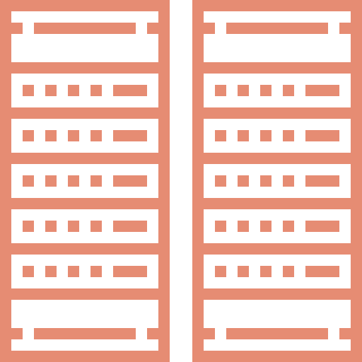
encoding in the real world
Oxen: A Teamster's Guide
Oxen: A Teamster's Guide
636.212
[14, 4, 23]
636.212
[14, 4, 23]
Notes:
So this funny encoding might seem uninterpretable. I’d argue that any decimal encoding is relatively arbitrary as it stands – there’s nothing about a “six” that inherently makes it ”applied science”, and certainly the average patron will take it as an abstraction rather than an inherent truth about the world. The subtree encoding, however, represents a literal point in space (not Euclidian space, to be clear, librarian space, which, never fear! I’ll elaborate on in my next research capstone). These “3D coordinates” represent shelf, row, and spot. Okay sure, so this sub-encoding makes potentially a little more semantic sense than other decimal systems, which is nice on its own. But this idea isn’t novel, it’s only a novel application to stacks in libraries. If you’re familiar with searching for resources in the digital world, like when you google something, this is exactly how these resources are stored, with addresses. Server farms are implemented the same way stacks in libraries are, so defining call numbers like we do memory addresses should be roughly the same, right? Easy as spinning up a new AWS instance?
Icon courtesy of: <div> Icons made by <a href="https://www.flaticon.com/authors/pixelmeetup" title="Pixelmeetup"> Pixelmeetup </a> from <a href="https://www.flaticon.com/" title="Flaticon">www.flaticon.com'</a></div>

Slide 11
drawbacks of encoding the real world
moving a file’s location is far easier than moving a book’s location
re-encoding a collection entails re-labeling every book
patrons who rely on muscle memory to arrive at the correct location get switched up on
Notes:
The physical limitations of the average library are very different than the physical limitations of server farms.

